Slide 1
LAb1 - RVC

Slide 2
Goals of the Lab
Requirement engineering
Analysis
Formalization (context diagram, FR, ..)
Consistency

Slide 3
High level, informal description
Since several years robotic vacuum cleaners (RVC) are available. An RVC is capable of cleaning the floors of a house in autonomous mode.
An RVC system is composed of the robot itself and a charging station. The charging station is connected to an electric socket in the house, and allows charging the battery on board of the robot.
The robot itself is composed of mechanical and electric parts, a computer, and sensors. One infrared sensor in the frontal part recognizes obstacles, another infrared sensor always on the frontal part recognizes gaps (like a downhill staircase). A sensor on the battery reads the charge of the battery. The computer collects data from the sensors and controls the movement of four wheels. Another sensor on one of the wheels computes direction and distance traveled by the robot.
Finally on top of the robot there are three switches: on-off, start, learn.
The learn button starts a procedure that allows the robot to map the space in the house. With a certain algorithm the robot moves in all directions, until it finds obstacles or gaps, and builds an internal map of this space. By definition the robot cannot move beyond obstacles, like walls or closed doors, and beyond gaps taller than 1cm.
The starting point of the learn procedure must be the charging station. When the map is built the robot returns to the charging station and stops.
The start button starts a cleaning procedure. The robot, starting from the charging station, covers and cleans all the space in the house, as mapped in the ‘learn’ procedure.
In all cases when the charge of the battery is below a certain threshold, the robot returns to the charging station. When recharged, the robot completes the mission, then returns to the charging station and stops.
The robot has also a USB port to be used by maintenance staff for diagnostics and possibly firmware update

Slide 4
4 documents
Requirements, system level
Requirements robot
Requirements firmware
Requirements charging station

Slide 5
System Requirements document
Business model
Stakeholders
Context diagram
Functional requirements
NF requirements
Table of access rights
Use cases / scenarios
Conceptual diagram / Glossary
System design
Deployment diagram

Slide 6
The core functions
Clean house
Learn space
Move autonomously

Slide 7
Business model
Answers those questions
Who? (customer segments)
Home segment (no industrial cleaning)
Basic model ( no app, no internet connection, no alexa..)
Why? (value proposition)
Save effort and time to clean house
Money flow? (revenue stream)
From users / customers

Slide 8
Context
Company X developing consumer devices willing to enter market (OEM)
Termozeta, beghelli
Philips, Siemens, hoover
dyson
Marketing office
Engineering office ( R&D)
Software office
Electronics and mechanical office

Slide 9
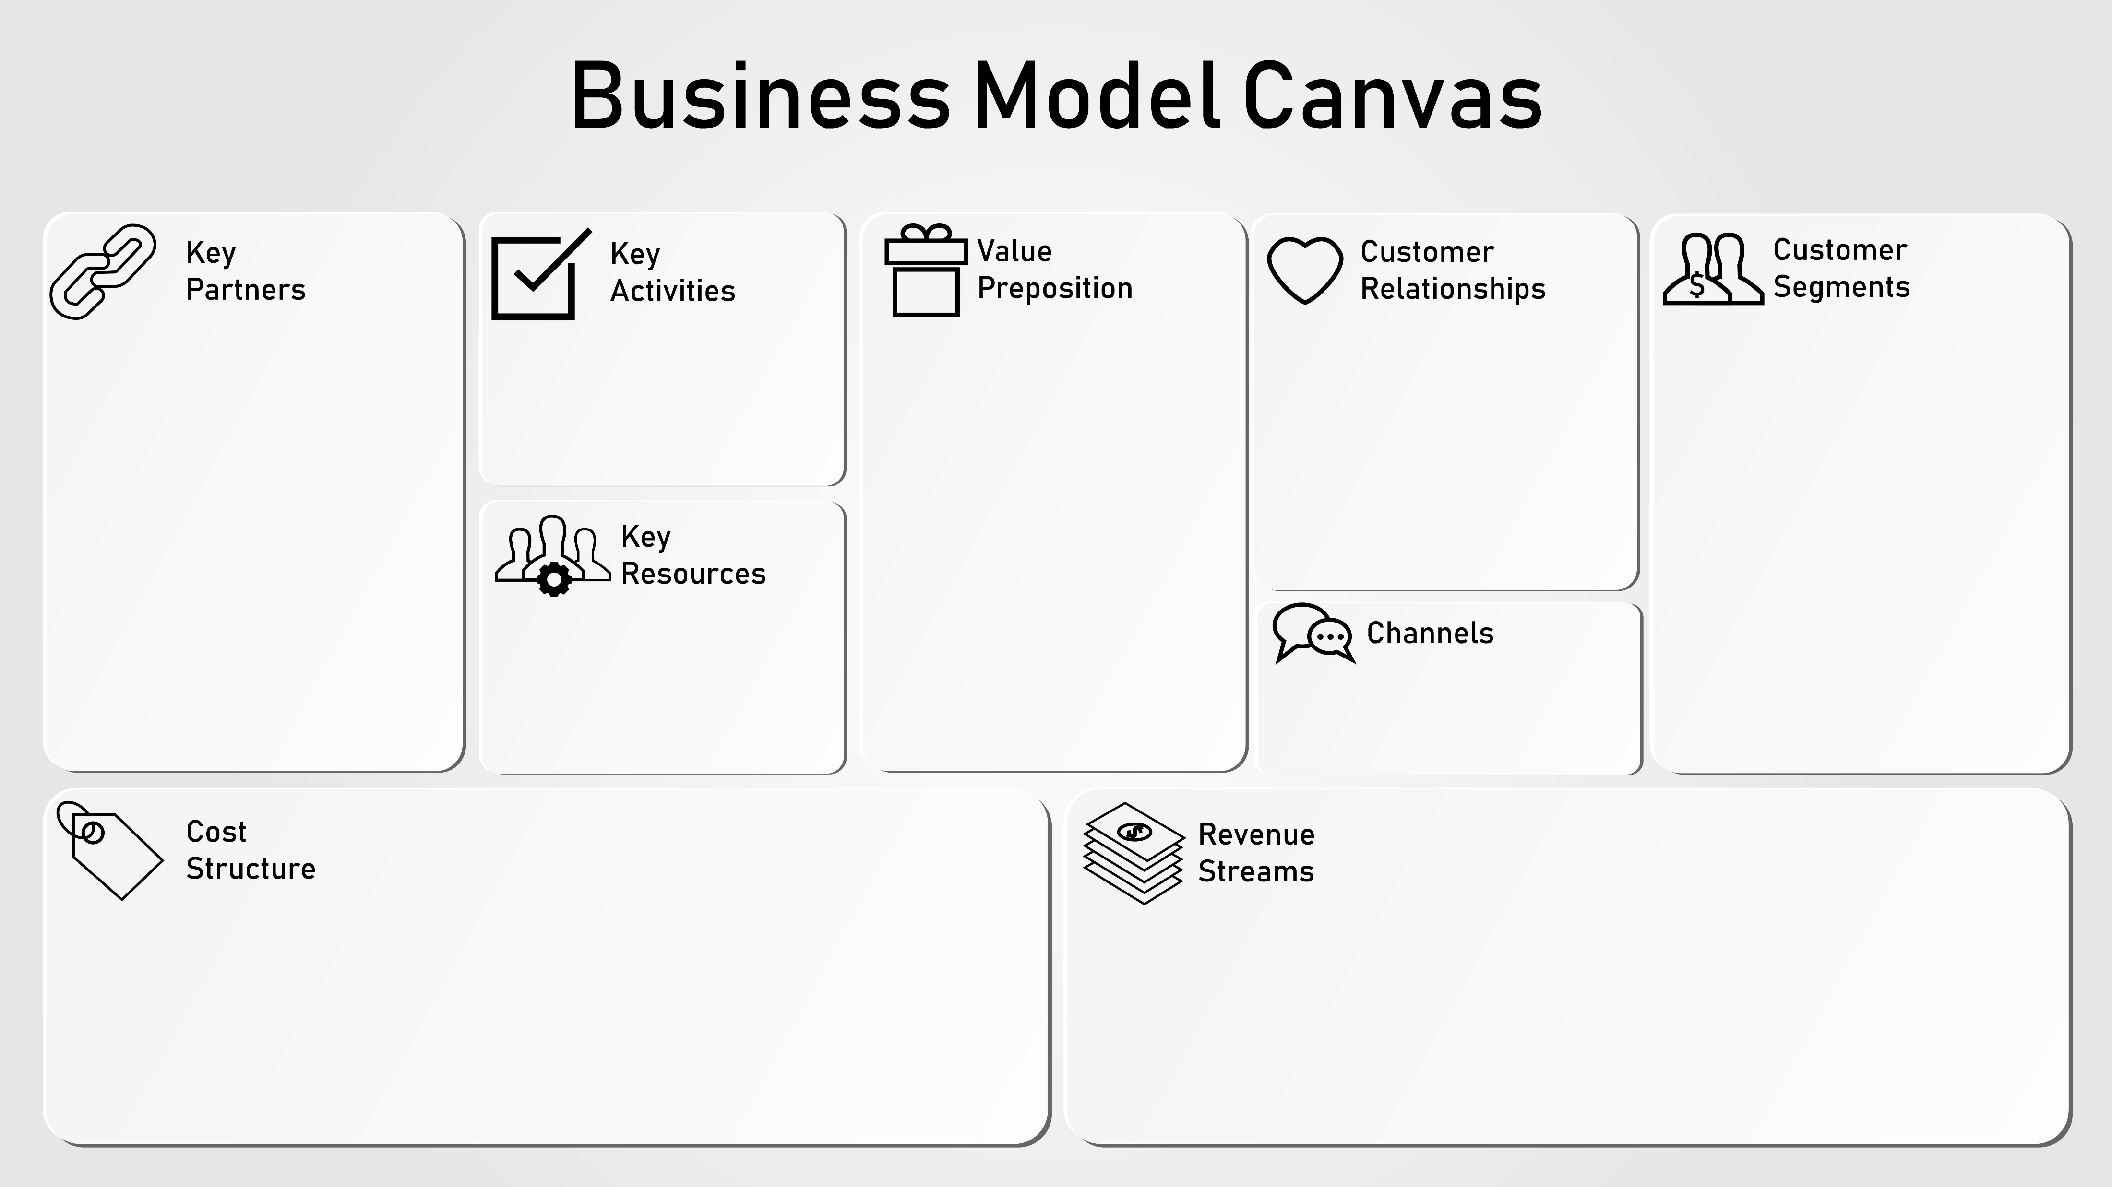
Business model
See Business model canvas

Slide 10
Stakeholders
End user
Marketing office
(should know requirements of end users, and define FR NFR for R&D)
R&D office
Sw developers
All suppliers of components used (tier1)
Hardware suppliers (memory, cpu, sensors.. )
Floor
Dust
Borders and obstacles
Maintenance staff

Slide 11
----- system requirements
Requirements, system level
Requirements robot
Requirements firmware
Requirements charging station

Slide 12
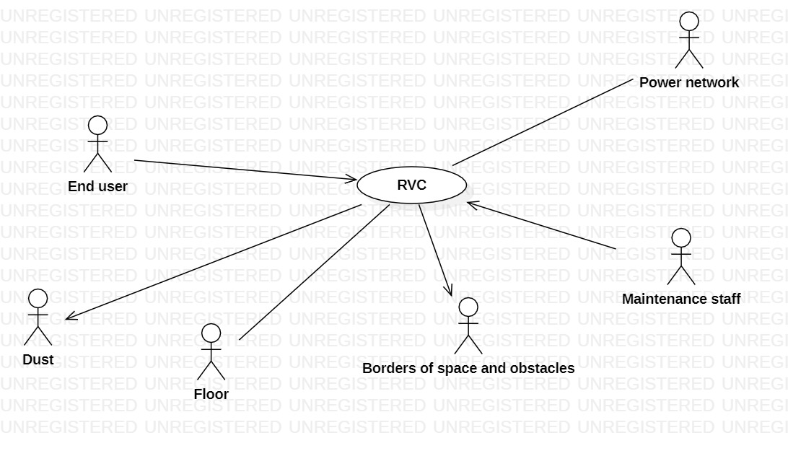
Context diagram

Slide 13
Interfaces
Actors | Physical interface | Logical interface
End user | 3 buttons display | Start , learn, clean Various signals (malfunctions)
Power network | Schuko plug | 220v, 50hz
Borders of space and obstacles | IR sensor for obstacle, IR sensor for gap | Recognize obstacle, recognize gap
dust | Air flow | Vacuum generation
floor | wheels | Move
Maintenance staff | Usb port type A | diagnostic Firmware upgrade

Slide 14
System design
Robot
Charging station

Slide 15
FR
Sys-FR1 | Manage movement
Sys-FR1.1 | go to charging station (go to position (x,y)
 | go straight
Sys-Fr1.2 | turn
1.3 | stop
1.4 | recognize obstacle
1.5
 | recognize gap
 | compute current position
FR2 | Monitor energy
Sys-FR2.1 | Charge battery
2.2 | Read energy capacity
2.3
 | Switch on / off
 | Clean space
 | Build map of space

Slide 16
FR
FR3 | Communicate with user
FR | Signal full (of dust)
 | Signal stuck
Fr | Signal energy low
1.3
1.4
1.5
Sys-FR4 | Maintenance
 | Diagnose system
 | upload new firmware
SysFR5 | Clean floor

Slide 17
Table of rights
 | End user | Maintenance staff
FR1 | Y | Y |  | N | N
FR2 | Y | Y |  | N | N
FR3 | Y | Y
Sys-FR4 | N | Y
FR5
FR6

Slide 18
NFR
NFR | Measure
Usability | Any person > 14 yrs old should be able to use system as follows: -first usage: have robot start mapping in < 5 minutes – first usage after mapping: have robot start cleaning in < 1 minute
 | weight <5kg
 | Any person > 14 yrs old should be able to change dust bag in < 2 min
Cost | System should cost < ?? euro
Efficiency | House up to 80sqm should be cleaned in < 1hr Mapping of space, first time, 80 sqm, should take < ?? minutes
 | Should clean efficiently (test: putting 10g of dust on 1sqmeter, after robot passes only 1 g on floor and 9g in dust bag)
safety | No harm to people, animals, things in the house
Reliability | Work for at least 1000 hrs before any component fails
Portability | No (does not apply to system)
maintainability | Possibility to change dust bag
security | No un authorized person should be able to control robot

Slide 19
Glossary
To be clarified:
House, Map, space, floor, position, obstacle, gap

Slide 20
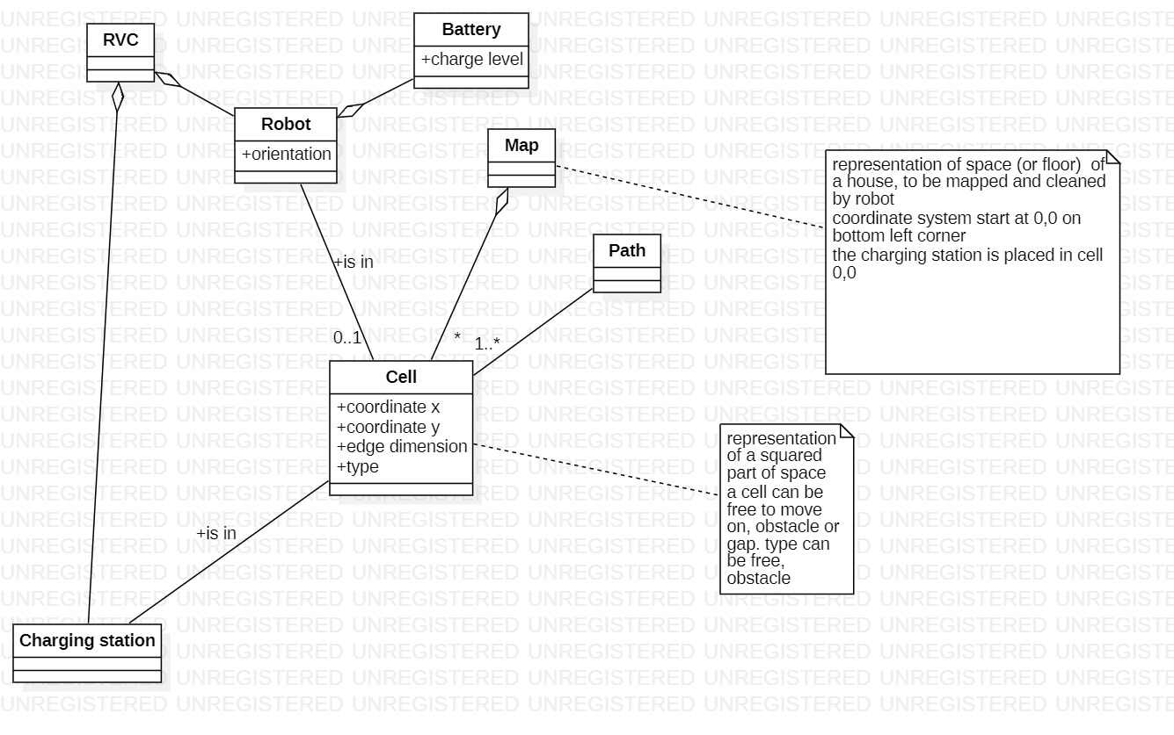
Glossary

Slide 21
Deployment diagram
Non useful here

Slide 22
---- robot requirements
Requirements, system level
Requirements robot
Requirements firmware
Requirements charging station
Context diagram
Interfaces
Fr
R-FR1 Read battery level
R-FR2 Manage movement
(TBD, nearly all requirements except part of manage energy are implemented by robot)
Nfr
System design
4 wheels
2 engines for moving 2 wheels
2 engines for rotating 2 wheels
Ir sensor obstacles
Ir sensor gaps
Battery
Battery Charge sensor
Computer and firmware
Dust bag
Sensor dust bag
3 buttons
Led for malfunctions
Vacuum pump
Requirement allocation
RFR1 is traced to SYS-FR2.1

Slide 23
NFR
Usability: same as for system
Cost: same as system minus cost of charging station
Efficiency: same as system
Translate to: battery at least ??maH
Consumption of engines…
Safety : same as system

Slide 24
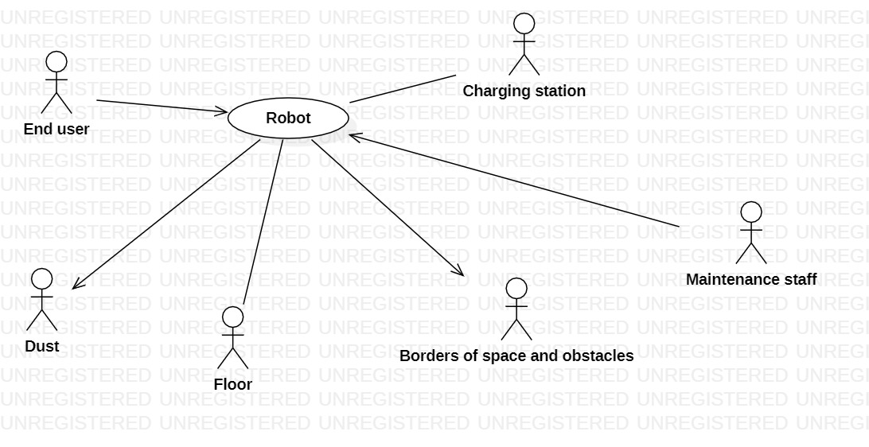
Context diagram

Slide 25
Interfaces
Actors | Physical interface | Logical interface
End user | 3 buttons | Start , learn, clean
Charging station | Two pole connector (to be further defined) | 20V dc, max X amp
Borders of space and obstacles | IR sensor for obstacle, IR sensor for gap | Recognize obstacle, recognize gap
dust | Air flow | Generate Vacuum
floor | Wheels | Move, rotate
Maintenance staff | Usb port type A | diagnostic Firmware upgrade

Slide 26
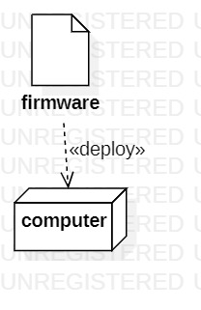
Deployment diagram

Slide 27
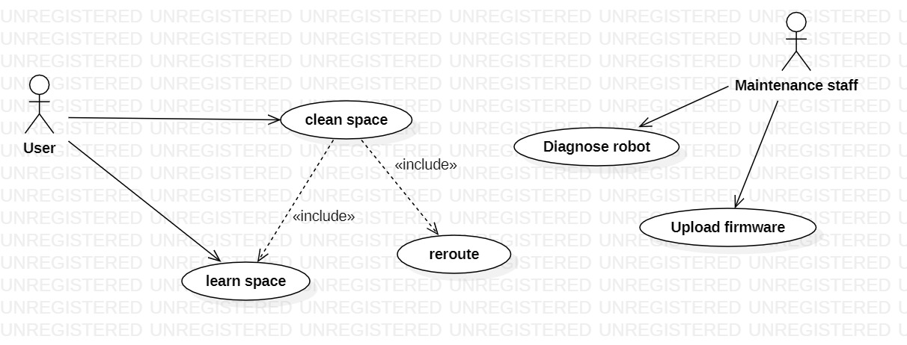
Use cases and scenarios

Slide 28
UC1 Clean space
Actor involved: end user
Goal: clean the space
Description: robot moves from charging station, following a path capable of covering the whole space, avoiding obstacle. In each cell the robot cleans dust, then proceeds to next cell. Finally robot returns to charging station
Scenarios: s1, s1V, s1-exc1, ..
exceptions: battery not enough

Slide 29
S1 (all right, no obstacles)
Precondition: robot is in charging station, battery is full, robot is working, map of space is available
Post condition: all cells of space are clean, robot is in charging station
End user pushes clean button
Robot starts diagnose procedure, result is ok
Robot computes path to cover all space (FW-FR1.3) (ex, path is cA1, cA2, c B2,..)
Robot starts vacuum pump
Robot moves to Ca1, stays enough time to clean it
Robot computes and updates its position and orientation
Robot moves to cA2,
Robot computes and updates its position and orientation
…
Robot back to charging station

Slide 30
S1V (all right, one obstacle found)
Precondition: robot is in charging station, battery is full, robot is working, map of space is available
Post condition: all cells of space are clean, robot is in charging station
End user pushes clean button
Robot starts diagnose procedure, result is ok
Robot computes path to cover all space (FW-FR1.3) (ex, path is cA1, cA2, c B2, cB3)
Robot starts vacuum pump
Robot moves to Ca1, stays enough time to clean it
Robot computes and updates its position and orientation
Robot moves to cA2,
Robot computes and updates its position and orientation
Robot recognizes obstacle in cell cB2 that was not in map. Robot computes turn around of cell cB2, and continues to cB3
…
Robot back to charging station

Slide 31
S1-exc1
Precondition: robot is in charging station, battery is full, robot is working, map of space is NOT available
End user pushes clean button
Robot starts diagnose procedure, result is ok
Robot does not move, and signals on display to do ‘Learn’

Slide 32
S1-exc2
Precondition: robot is in NOT charging station, battery is full, robot is working, map of space is available
End user pushes clean button
Robot starts diagnose procedure, result is ok
Robot does not move, and signals to put it in charging station

Slide 33
S1-exc3
Precondition: robot is in charging station, battery is NOT full, robot is working, map of space is available
End user pushes clean button
Robot starts diagnose procedure, result is ok
Robot does not move, and signals on display to do wait to finish charging

Slide 34
S1-exc4
Precondition: robot is in charging station, battery is full, robot is NOT working, map of space is available
End user pushes clean button
Robot starts diagnose procedure, result is NOK
Robot does not move, and signals ‘broken, call maintenance’

Slide 35
S1exc5 (someone moves robot in middle of mission)
Precondition: robot is in charging station, battery is full, robot is working, map of space is available
Post condition: robot stops and waits for user intervention
End user pushes clean button
Robot starts diagnose procedure, result is ok
Robot computes path to cover all space (FW-FR1.3) (ex, path is cA1, cA2, c B2,..)
Robot starts vacuum pump
Robot moves to Ca1, stays enough time to clean it
Robot computes and updates its position and orientation
Robot moves to cA2,
Robot computes and updates its position and orientation
---- someone moves robot
Robot recognizes map is wrong
Robot stops and signals on display: ‘bring back to charging station’

Slide 36
S1exc6 (not enough battery)
Precondition: robot is in charging station, battery is full, robot is working, map of space is available
Post condition: space not fully cleaned, robot in charging station
End user pushes clean button
Robot starts diagnose procedure, result is ok
Robot computes path to cover all space (FW-FR1.3) (ex, path is cA1, cA2, c B2,..)
Robot starts vacuum pump
Robot moves to Ca1, stays enough time to clean it
Robot computes and updates its position and orientation
Robot moves to cA2,
Robot recognizes not enough charge to finish cleaning
Robot stops vacuum pump
Robot computes path P-BACK to charging station
Robot follows P-BACK

Slide 37
UC2 Map space
Actor involved: end user
Goal: map the space
Description: robot moves from charging station, applying an algorithm to cover a graph so that all cells are tagged as free or obstacle or gap. In the end the space is described by a map
Scenarios: s2
exceptions: battery not enough, robot breaks, robot not in charging station, map already exists

Slide 38
S2 (all right, map produced)
Precondition: robot is in charging station, battery is full, robot is working, map does not exist
Post condition: map is produced (every cell in space is tagged free, obstacle or gap), robot is in charging station
End user pushes learn button
Robot starts diagnose procedure, result is ok
Robot moves to cell xy applying coverage algorithm
Cell xy is free (no obstacle found), cell xy is tagged as free in map
Robot moves to cell kw applying coverage algorithm
Cell kw is not reachable, cell is tagged as obstacle
..
…(until all cells tried and tagged)
Robot back to charging station

Slide 39
S2-exc (map already available)
Precondition: robot is in charging station, battery is full, robot is working, map exists already
Post condition:
End user pushes learn button
Robot asks ‘are you sure?’
End user does nothing
Robot does not move

Slide 40
---- charging station requirements
Context diagram
Interfaces
Fr
Charge battery
Nfr
System design
Transformer 220v ac to 20v dc
..
Requirements, system level
Requirements robot
Requirements firmware
Requirements charging station

Slide 41
---- firmware requirements
Requirements, system level
Requirements robot
Requirements firmware
Requirements charging station
Context diagram
Interfaces
Fr
(nearly all robot-fr will be partially or fully allocated here. Ex ‘movement’ is allocated to wheels and wheel engines for actual movement, and to firmware for controlling movements)
Nfr
Glossary
(software design)

Slide 42
FR
ID | description | Traced to
FW-FR1 | Manage movement | R-FR2
 | Compute path to charging station Compute energy needed for covering path (path) Compute time needed for covering path (path)
 | Build map
FW-FR1.3 | computeOptimalPath to cover all map and return to charging station
FW-FR1.5 | followPath Reroute in case of obstacle (recompute path) Compute robot position and orientation Recognize that map is wrong (space does not match with map, ex someone has moved the robot)
 | moveRobotforward(distance) moveRobotBackward(distance) Stop
 | turnRobotRight(degrees) // controls rotation and movement of two wheels to turn robot on the spot turnRobotLeft(degrees)
 | Manage Sensors
 | Read battery capacity Read max battery capacity Read battery error condition
 | Move wheel (id wheel, degrees)
 | Rotate wheel (id wheel, degrees)

Slide 43
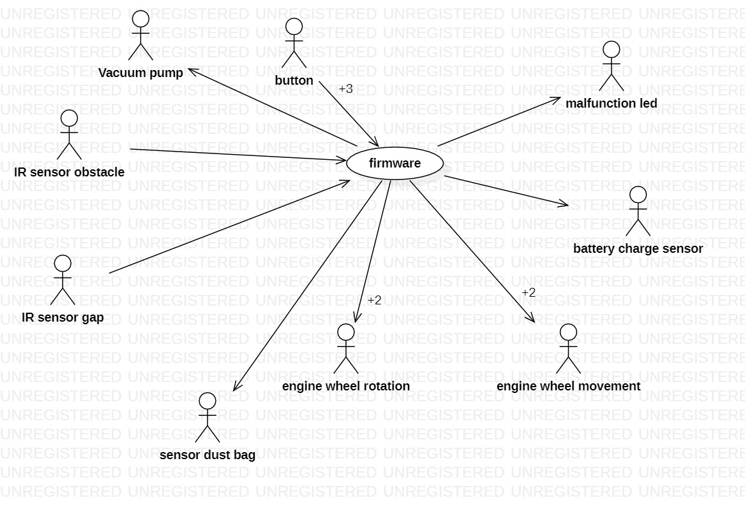
Context diagram

Slide 44
Interfaces
Actors | Physical interface | Logical interface
Button on off |  | Variable Y, true false Start , stop
Button learn
Ir obstacle sensor |  | Variable Z,
Battery sensor |  | Variable B, long int 0 = 0 charge Maxint = 1Ah Variable Berror, short int 1 =error1 2 = error2 Variable MaxC..
Interfaces to be further defined, depending on the actor (component)
Ex the obstacle sensor could be either connected to an interrupt function (interrupt, asynchronous model), or via a memory variable to be read regularly (polling model)

Slide 45
Embedded system
logic
sensors
actuators

Slide 46
System process
System Requirements engineering
System Requirement
System design
System design
Hardware development (requirement, design, implementation, test)
Software process (requirement, design, implementation, test)
Hardware
Software
System integration, test
System

Slide 47
Software process
Requirement inspection
Requirement engineering
Requirement
document
Design inspection
Architecture and design
Test, code inspection
Design
document
Implementation
Software
system
Configuration management
Project management

Slide 48
System vs sw requirements
System requirements
Functional
F1
F2
F3
Non functional
NFR1
NFR2
Software requirements
Functional
SWF1
SWF2
SWF3
Non functional
SWNFR1
SwNFR2

Slide 49
System vs software requirement
System context diagram
Software context diagram

